Slide 1
From Fragmentation to Alignment: A Systemic View of ACEs & Trauma-Informed Systems
Notes:
Our goal today is to align and concretize our organization’s initiatives and imperatives around trauma, trauma informed systems, equity and ACEs and discuss how they all fit together.
We know that stress, adversity and trauma are public health issues. That stress is linked to the 6 leading causes of death in the United States. That trauma has a ripple effect that impacts not only the individual experiencing trauma but their family, community and also intergenerationally. We know that some communities are disproportionately affected by oppression, poverty and trauma.
A systemic, preventative approach is required to address these issues. There is a focus and an investment in this work at the local and statewide level at the moment, which our clinic is involved in: outline current org initiatives in this area
There are many frameworks for Trauma-Informed Care including SAMHSA, Trauma Transformed, etc. One of the challenges in the Trauma informed movement is the use of different terminologies. For purposes of this slide set, the definition of Trauma Informed Care comes from Trauma Transformed – is being used to understand the relationship between the providers, patients, and families. Trauma Informed Systems is referring to the way organizations prepare and develop practices and policies throughout the organization. To learn more, go to https://traumatransformed.org/
In this slideset, terminology related to ACEs screening and response, comes from the TRIADS approach website cthc.ucsf.edu/triads and ACEsAware.org

Slide 2
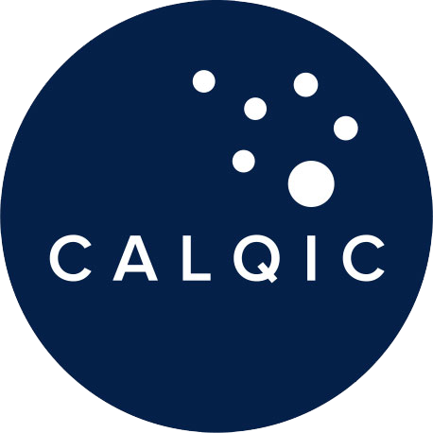
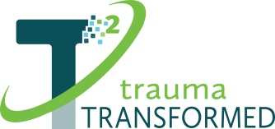
This slide deck was created and presented by Ken Epstein, PhD LCSW, through his work with Trauma Transformed and CALQIC.
Notes:
Our goal today is to align and concretize our organization’s initiatives and imperatives around trauma, trauma informed systems, equity and ACEs and discuss how they all fit together.
We know that stress, adversity and trauma are public health issues. That stress is linked to the 6 leading causes of death in the United States. That trauma has a ripple effect that impacts not only the individual experiencing trauma but their family, community and also intergenerationally. We know that some communities are disproportionately affected by oppression, poverty and trauma.
A systemic, preventative approach is required to address these issues. There is a focus and an investment in this work at the local and statewide level at the moment, which our clinic is involved in: outline current org initiatives in this area
There are many frameworks for Trauma-Informed Care including SAMHSA, Trauma Transformed, etc. One of the challenges in the Trauma informed movement is the use of different terminologies. For purposes of this slide set, the definition of Trauma Informed Care comes from Trauma Transformed – is being used to understand the relationship between the providers, patients, and families. Trauma Informed Systems is referring to the way organizations prepare and develop practices and policies throughout the organization. To learn more, go to https://traumatransformed.org/
In this slideset, terminology related to ACEs screening and response, comes from the TRIADS approach website cthc.ucsf.edu/triads and ACEsAware.org

Slide 3
Our North Star
Understanding the connection between trauma-informed care principles allows organizations to promote healing at different levels
Trauma Inducing
Trauma Reducing
Trauma-Organized
Trauma-Informed
Healing Organization
Reactive
Reliving / Retelling
Avoiding / Numbing
Inequity
Authoritarian Leadership
Understanding of the Nature of the Impact of Trauma Recovery
Shared Language
Recognizing Socio-Cultural Trauma and Structural Oppression
Reflective
Making Meaning Out of the Past
Growth + Prevention-Oriented
Collaborative, Equity, and Accountability
Relational Leadership
Notes:
There is a lot of conversation about trauma informed care and trauma informed practices, all of which can give providers a more holistic perspective for healing children and families from trauma that often stems from ACEs. Starting at the left, our organizations can be often trauma organized (chaotic, authoritarian, hierarchical, fragmented, reactive, overwhelmed). For example, organizational practices such as privileging leadership and upholding hierarchies do not value the existence and experience of everyone at the organization. This can cause distress and lead to a toxic organizational culture. And then moving to the middle, in the process of healing and trying to reduce the amount of trauma that is happening within our organization, we become trauma informed.
With trauma-informed, we are centering trauma not only in the care we provide but in the system through which it is provided. In TIC, we are centering the experience and the story of the patient. Being trauma-informed is a railway station on the way to being a healing organization. Trauma-informed is not the endpoint. A healing organization is the north star.
A healing organization is an outcome of a trauma-informed system. Healing organizations center not only the experience and impact of trauma, but the process of healing from it. It helps people thrive in a culture of wellness. They are integrated and collaborative, act with integrity and authenticity, and help us make meaning of and learn from difficult experiences. Healing organizations strive toward growth and development, prevent burnout and vicarious trauma, and are willing to adapt to the context and needs of those we serve as well as those who serve them. Equity and accountability are prioritized in practices, policies and relationships. Imagine an organization that has reflective practice built into all of its work. Imagine, the organization has organizational care, not just self care. Imagine an organization that funds the wellness of its staff appropriately. Imagine meetings that are inclusive and supportive.
Ultimately for organizations to be healing we need to measure ourselves about how integrated and reflective and collaborative and relationship centered and growth and prevention oriented we are. And in such an instance we can reduce our trauma, we can move from inducing trauma to reducing trauma for our patients.
All of these initiatives, from ACEs, TIC to Equity, represent frameworks for individual and organizational culture change that are best aligned in order to help us work towards the common goal of becoming a healing organization.

Slide 4
People experience trauma at different levels
Environmental Trauma
Sociocultural, Institutional,and Historical Traumas
Community Traumas
Individual and Family Trauma (including ACEs)
Individual and Family Trauma (including ACEs)
Notes:
People experience trauma at different levels. That includes all people in a health care setting: patients, staff, leadership, etc.
Concretely, trauma happens in relationships. And because trauma happens in relationships it must be healed in the contexts of relationships. This ranges from interactions with patients and families, between staff and disciplines across organizations, and in our relationships with our communities. Here you see the different levels of traumas that our patients can experience, with ACEs as one example at the individual level moving all the way up to institutional and historical traumatic experiences and climate or environmental trauma inflicted upon Earth and the natural world.
Health care institutions typically operate from reactive places and change only happens in reflective spaces. Healing from trauma requires reflection and requires us to systematize space for reflection. ACEs screening represents an opportunity to propel health care organizations to interrogate and translate the patient and family experience with adversity into a clinic and organizational culture focused on safe, nurturing, culturally and racially sensitive spaces to promote healing in the context of relationships. Our most powerful evidence is the ways in which connected relationships help us heal emotionally, physically and spiritually.
ACEs screening is one key component of building a more trauma-informed system. In order to be trauma informed, you need to understand the nature of components of trauma, the level of stress someone and/or a family is experiencing, and the ways resilience can be promoted and nurtured. ACEs screening provides an entry to a healing conversation, as well as an avenue to interrogate behaviors, structures and policies and procedures that induce trauma to comprehensive ways to systematically reduce trauma and identify and provide the care and resources needed to heal.

Slide 5
The path to reflective spaces
in reactive places
The path from trauma-informed to healing organizations is not linear. It is personal, organizational, systemic, and generational.
Photo by Luca Bravo on Unsplash
Notes:
Our work as leaders, practitioners, clinicians, administrators and direct care staff is to look in the mirror and the landscape, as the picture here does. This process of Self Inquiry (the mirror) and organizational inquiry (the landscape) involves, as Dr. Kenneth V. Hardy has said, “seeing, being and doing.” (https://eikenbergacademyforsocialjustice.com)
We have to see the current conditions and the complexities of inequities and practices that sustain and induce trauma.
We have to assess our values, experiences, and biases to understand how we are evaluating processes, developing practices, implementing policies and making decisions.
We then can be better equipped to “do” in ways that do not increase harm induce trauma and/or sustain inequity.
There is no trauma-informed or ACEs screening without racial equity. One that acknowledges that trauma occurs on an individual/family level (ACEs and other traumas), at a practice level (eg, a patient’s prior), at an organizational level (TIS), and on a societal level (Structural and Historical Inequities) requiring social and racial justice centered policies and behaviors.
Addressing and aligning our culture change initiatives provides our best opportunity to interrupt the cycles of trauma generated by the system and inflicted on communities that have been marginalized. The vision is to support and build a culture that promotes resilience and healing - this work will help us achieve that aim.

Slide 6
How would you align these initiatives to promote sustainable organizational culture change?
Trauma Informed Care
ACEs Screening and Response
Racial Equity and Justice
Notes:
All of these adjacent initiatives focus on organizational culture change, but this isn’t culture change in silos, and nor are these competing initiatives.
The goal of ACEs Screening and response is to identify adversity, build resilience and strengthen healing through relationships and, when indicated, trauma-specific treatments and/or referrals. ACEs Screening and Response, Trauma informed care, and Racial Justice are inextricably connected to each other, and tied together by an understanding of trauma, resilience and healing through relationships. These are different and what appear to be competing initiatives, but there is alignment between them. Let’s discuss how we can develop a shared understanding and language about early adversity, trauma, and strategies for healing, and how to adapt and align these ideas for a systemic, preventative approach in our org.

Slide 7
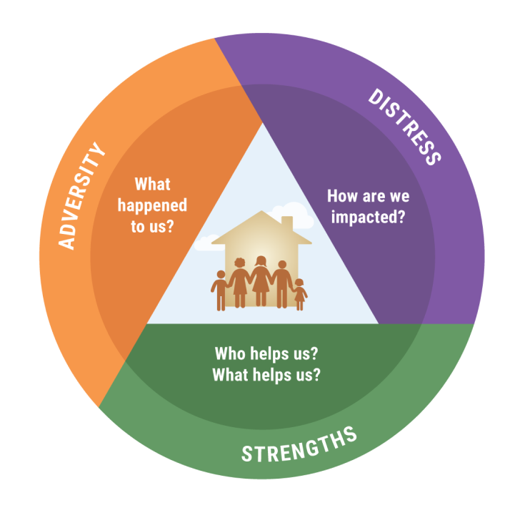
An entryway for trauma informed care
•https://cthc.ucsf.edu/triads/aces-coaching/aces-coaching-scenario-5/
Notes:
ACEs screening gives us a concrete place to begin building trauma informed inquiry in our clinical settings, an entryway that allows us to understand how stress contributes to disease in our patients. It’s a tool that can assess the risk of toxic stress, a diagnostic step to identify the scope of a larger problem, which is trauma. We cannot be trauma responsive unless we consider individual experiences of adversity. That’s why it’s at the top of the pyramid here, and as we move down, we see that screening is a entryway for enhanced communicating and understanding of ourselves, our colleagues and our patients.
ACEs screening is a conversation about adversity. Adversity is part of the human condition. Stress is part of living. However, as the amount of distress increases we rely even more on our strengths which promotes our ability to cope. This is true across our organizations. The more distressed the organization the more problematic the culture will be which directly impacts patient care. Organizational leader engagement and support for promoting a humane and protective culture helps build a healing organization. Screening isn’t just an individual conversation but an organizational catalyst by which we can understand how our organization is doing, what we need to screen for ACEs and to organize ourselves around trauma informed principles and racial justice.
** NOTES FROM SLIDE 7 IN PREVIOUS DECK **
Ultimately, these things go hand in hand and it’s about peeling back the layers and understanding trauma and resilience at different levels, at the individual/interpersonal level, the community level, and the system/institutional level. Engaging patients in this way through screening necessitates trauma informed values and we can conceptualize screening as a small, concrete component inside a larger trauma informed system.
Can we screen without supporting a trauma-informed organizational foundation? Yes, but we know it likely won't be as effective or sustainable and can increase the chance of harm.
In the same way, can we have a Trauma-Informed and socially just health system without understanding, screening and helping reduce high levels of adversity our patients and families have or are experiencing? We think these are both intrinsically connected.
Reactive organizations can induce trauma while healing organizations can reduce trauma in our staff, community, patients and families. Adopting trauma informed principles resourcing the application of those principles facilitate ACEs screening and organizational health.

Slide 8
The 3 C’s
Connection
Coherence
Collaboration
Meet each other with compassion and respect
No one can upshift from survival brain into thinking brain unless we feel safe
We’re wired to heal together, therefore we need to collaborate
Notes:
So we have ACEs screening, we have ongoing racial equity work, we have our trauma-informed workgroup. How do we relate this to the organization we’re operating in? The connecting tissue is the three C’s.
The first C is Connection. Absent connection there isn’t healing. There are micro things we can be doing to think about connection. You can check in in meetings, you can greet everyone at work. Ask them “how they’re holding up” the “how are you’s” are just not working these days, so “how are you holding up”. You can express gratitude, put up a gratitude board. You can have structured brief check ins with colleagues, especially after heavy moments.
The second C is Coherence. Coherence is important because when trauma happens, chaos happens. And coherence is important in our organizations and for ourselves to create coherent stories, and that includes focusing on physical safety. Like Alicia Lieberman says “Speaking the unspeakable.” Repeating what someone has said and letting them know you got it. So often, people say that healing comes from being heard. Often we want to do something, but sometimes all we can do is hear somebody, address differences and facilitate healing.
The third C is Collaboration. The context of collaboration can be putting together groups that reflect on data together. For example, our ACEs data could be reflected on together as opposed to making decisions in isolation. Putting staff members together to get insights and diverse experiences. Theme day - having mindful Mondays, Teaching Tuesdays, Wellness Wednesdays - intentionally trying to build these practices into your environment. Developing a staff support outreach team who can meet with staff when they’re having difficulty. We can consider how to incorporate the 3 C’s as we integrate healing practices and move towards becoming a healing organization.

Slide 9
“A resilient organization is able to adapt and thrive in times of uncertainty, pressure and ambiguity.
Succeeding as an organization is much more likely when we build resilience into our strategy, culture and day-to-day practices. A resilient organization enables individual resilience.”
– The Resilience Institute
Bloom & Farragher, 2013
Notes:
This quote demonstrates a different way of thinking since our current structures can rob us of resilience. As opposed to us giving people resilience, we can build resilience and healing practices in our organizations that allow us to both benefit from our own resilience and use the organization as a way to enhance that. Ultimately, all of these initiatives provide synergy, scaffolding and alignment towards the common vision of a resilient, healing organization.

